Slide 1
Project Bank Bot AI Chatbot For Banking FAQs
Vallivedu madhuri Reddy

Slide 2
Project Overview
Redefining Banking Accessibility with AI

Slide 3

OUR Vision
A Personal Banker in Your Pocket
Our vision is to democratize access to financial information. By leveraging Natural Language Processing (NLP), Bank_Bot understands user intent and provides accurate, secure, and human-like responses instantly.

Slide 4
The Challenge & Our Solution
The Problem
Customers currently face long wait times for simple queries like balance checks and transaction history. Traditional support hours are limited, leaving users frustrated during off-hours.
The Solution:
Bank Bot AI is an intelligent conversational agent available 24/7. It instantly resolves routine banking queries, reducing operational costs and significantly enhancing customer satisfaction.

Slide 5
MileStone 1:Core Features
Balance Check
Mini Statement
Smart FAQs
Instant real-time retrieval of current account balance with simple text commands.
View the last 5 transactions instantly to track recent spending activity.
Automated answers to common questions regarding bank policies, hours, and services.

Slide 6
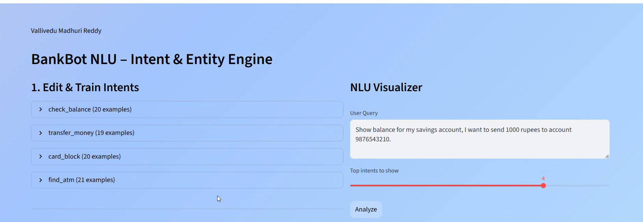
Train Intents & NLU Visualizer

Slide 7
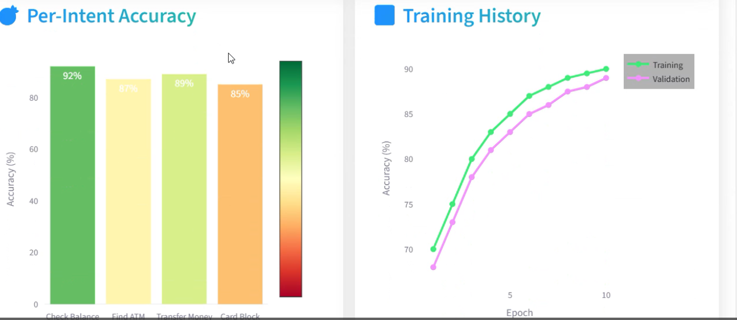
Intent Analysis

Slide 8
Milestone 2:Core Features
User Interface
DataBase Managemnet
Its having the register, login.
It also having chat bot applications
Ui having chat analysis
Its also having help and history
Here whatever we are register that savings that should affect on SQLite
We can alter, create, delete the database data.

Slide 9
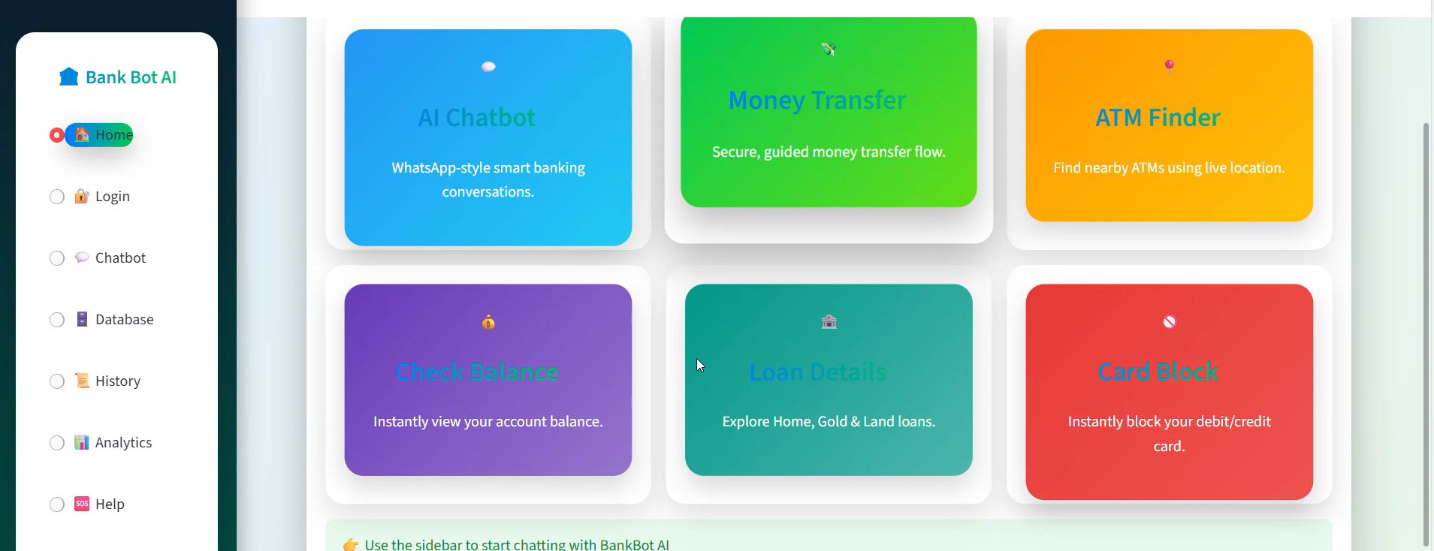
ChatBot Home Page

Slide 10
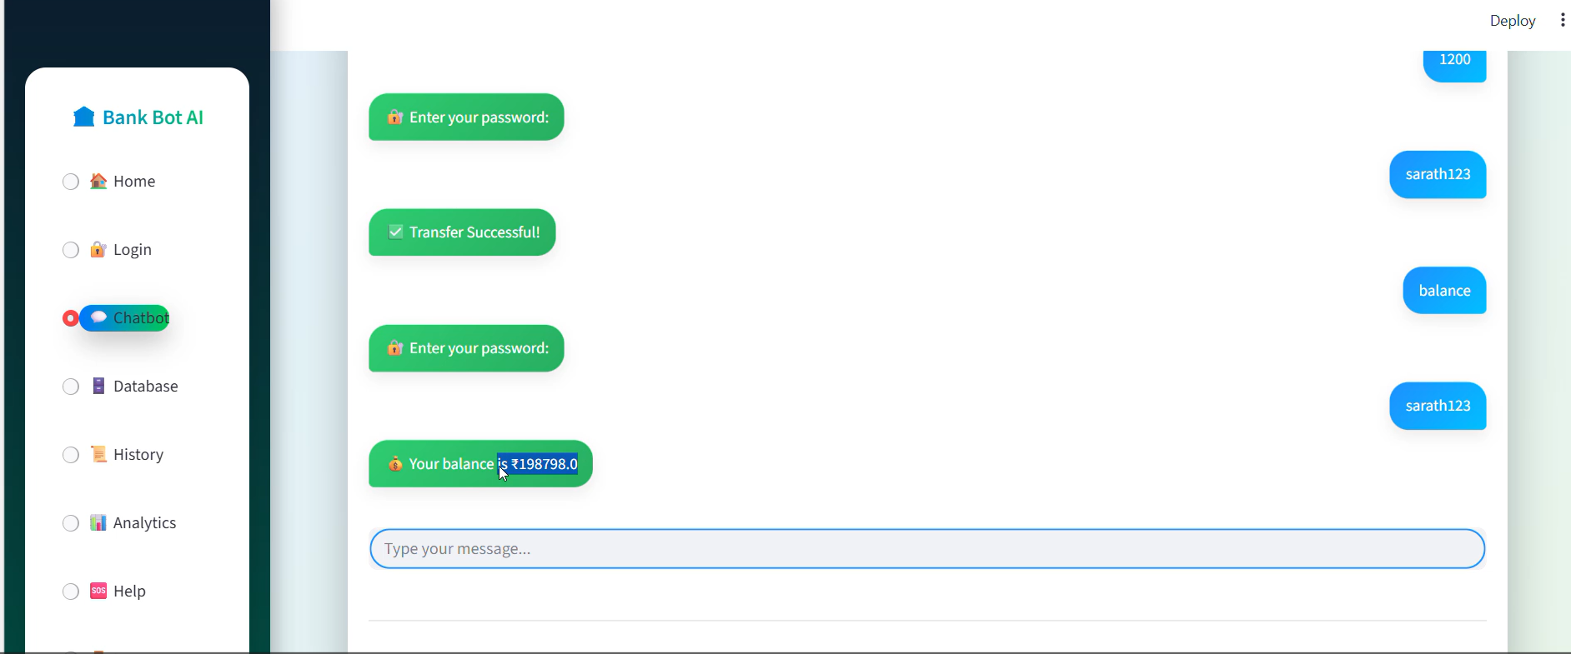
Chatting application

Slide 11
Milestone-3:CoreFeatures
It having transfer money, check Balance, Find ATM, Loan Details, and Block Card.
We Can Integrate the Grok_API Key to the chatbot that it can answer to whatever you ask the chatbot.

Slide 12
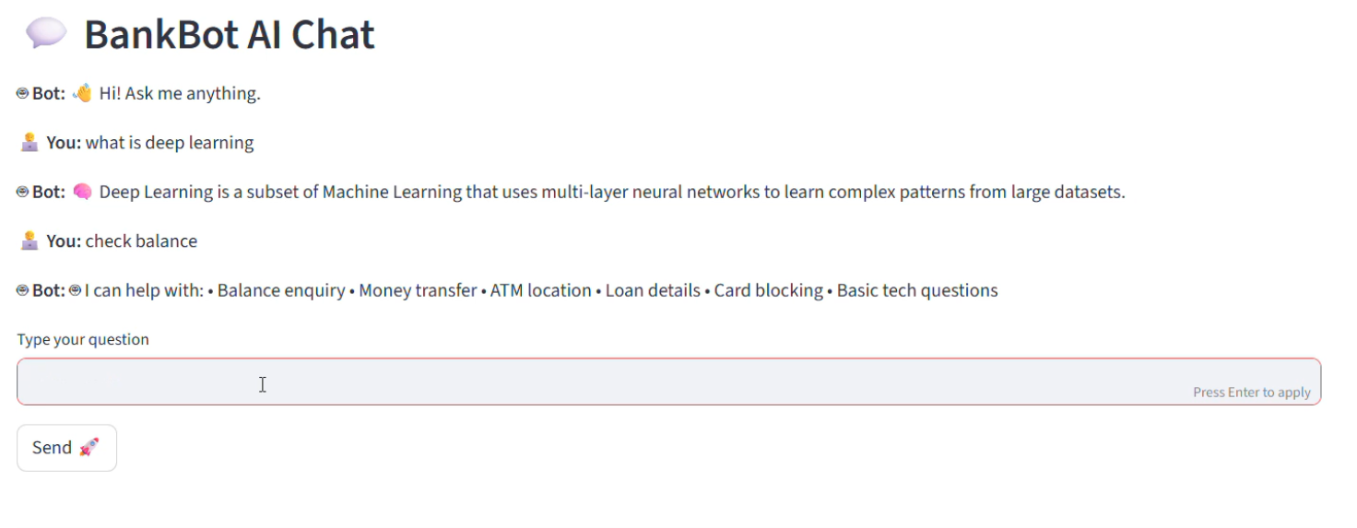
Chat Bot having Grok APi

Slide 13
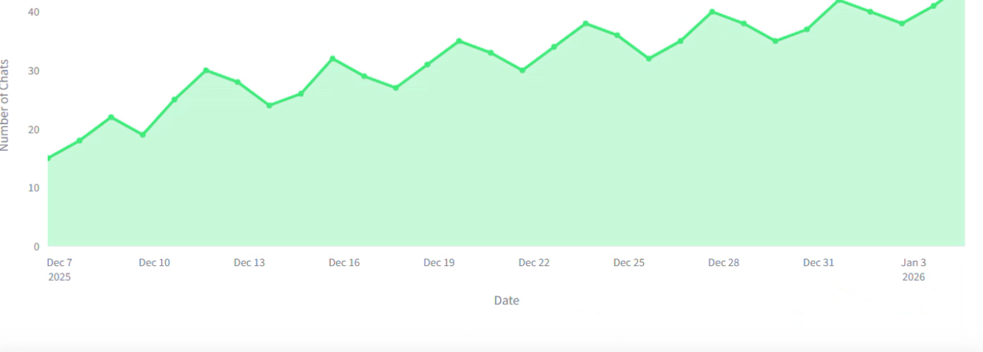
Chat Analysis:

Slide 14
MileStone-4:Core Features
ADMIN PANEL
In these milestone it explains about all intent manager,intent analysis that we can perform CRUD operation.
In it e can see the Chat_Analysis.
Chat Export &Analysis
In these we can export the chat in json,html,and markdown.
We can manage whole data and user Management.
We can analysis chat by different pictorials.

Slide 15
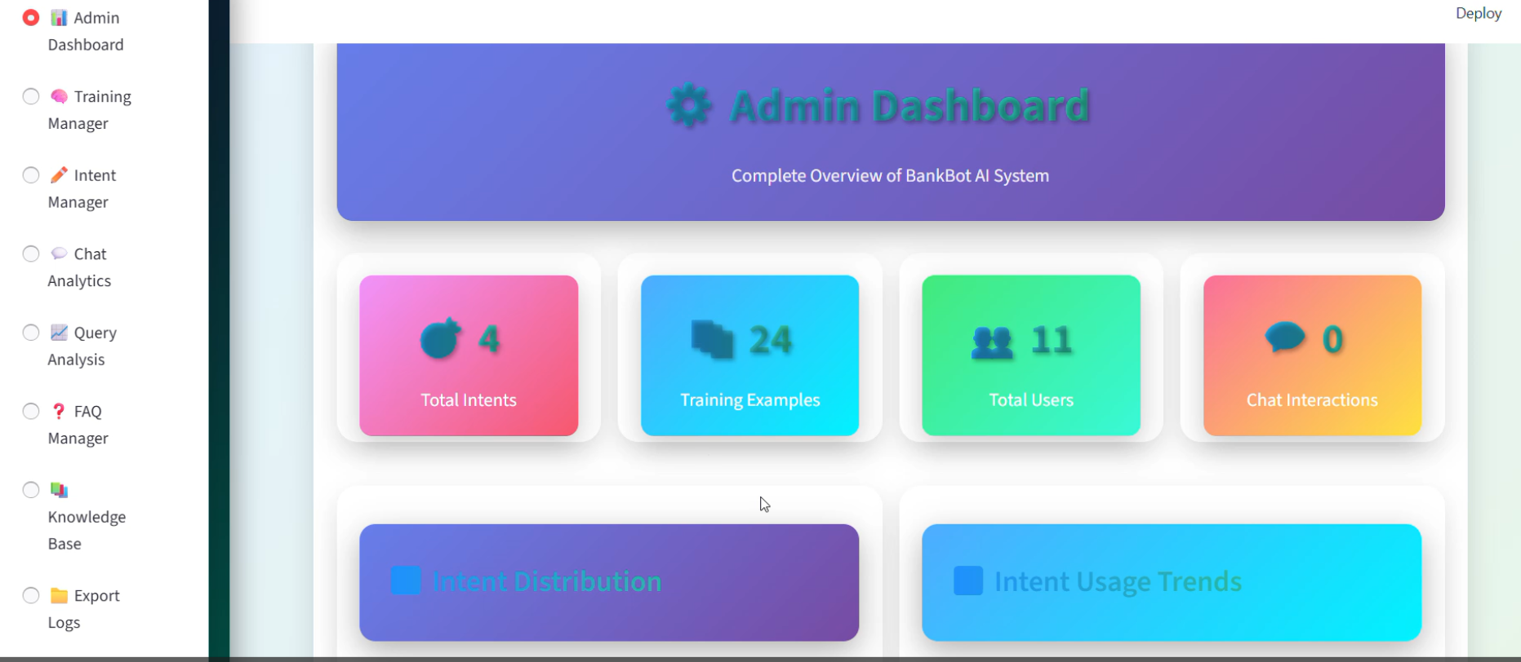
Admin DashBoard

Slide 16
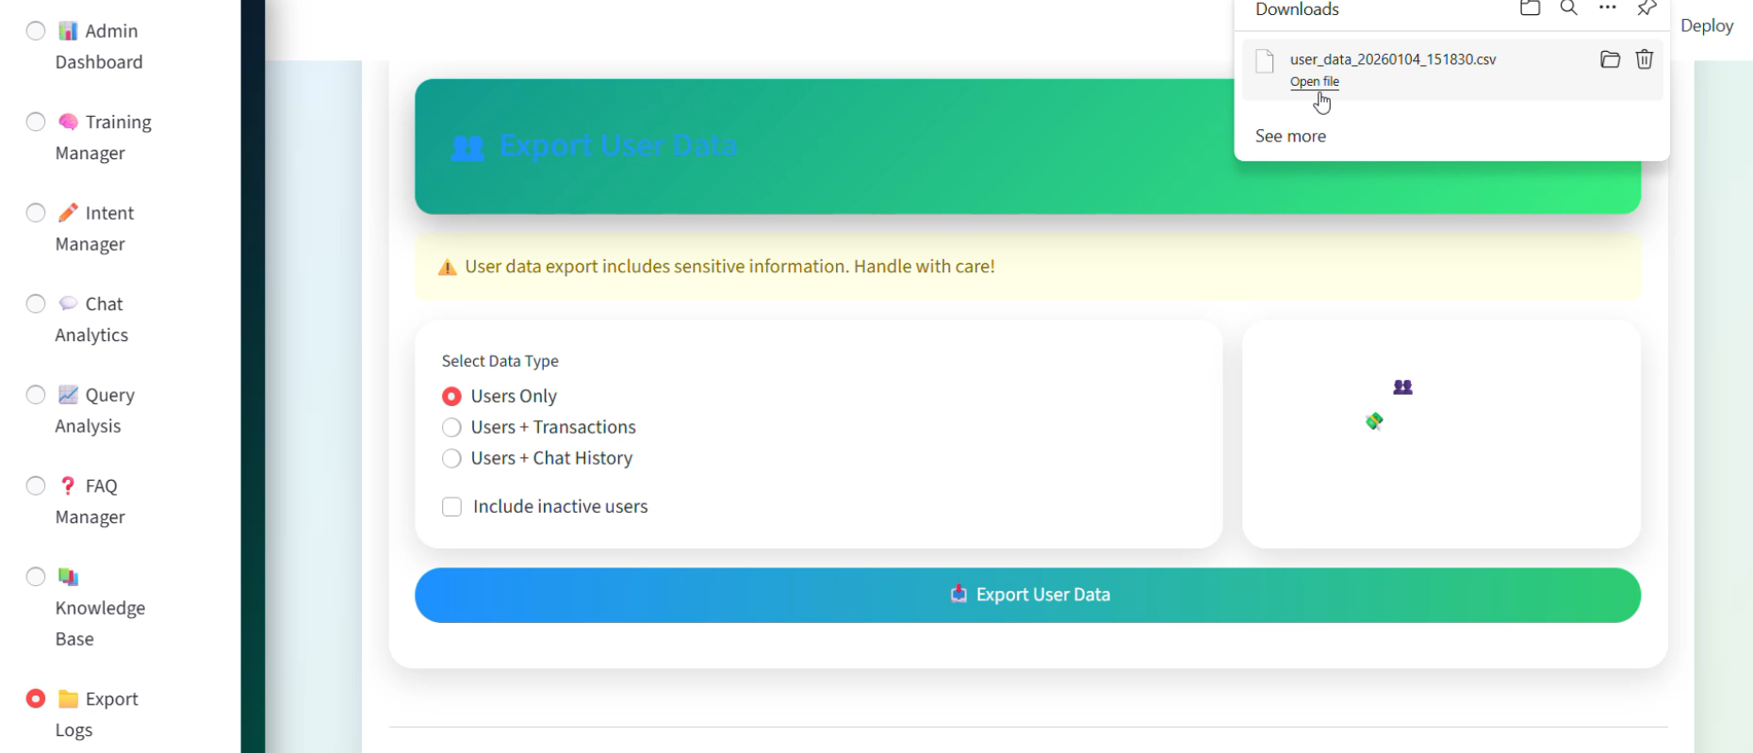
Export Details

Slide 17
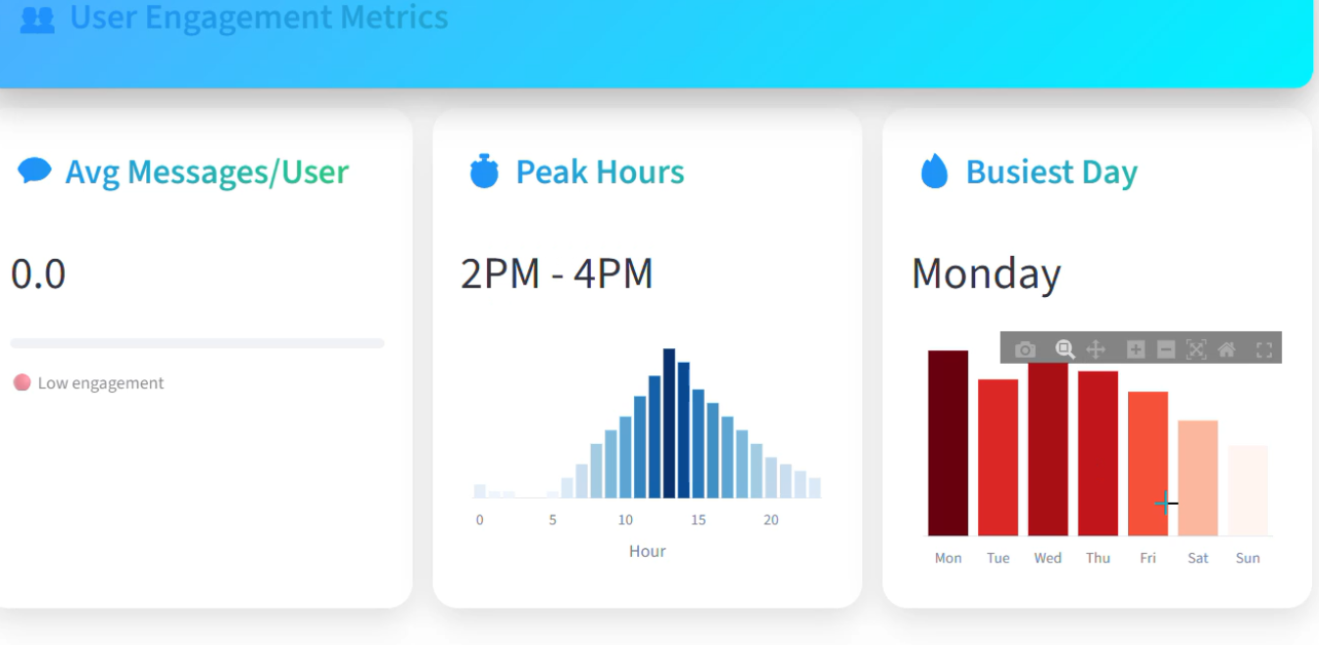
Chat Analysis:

Slide 18
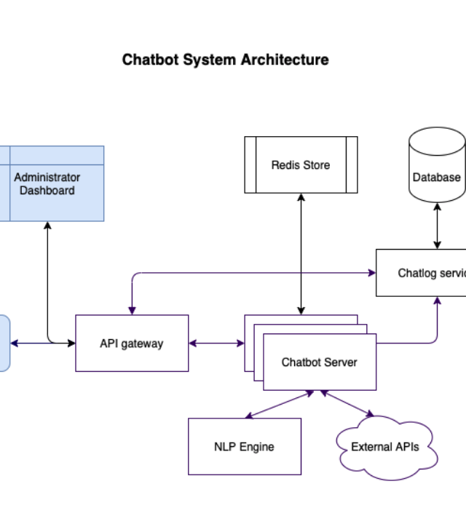
System Architecture
Concept:
This modular design ensures security and scalability.
1. User Interface: The customer interacts via the chat app.
2. NLP Layer: The bot processes natural language to understand 'Intent' (e.g., Check Balance).
3. Business Logic: The backend verifies credentials and formats the request.
4. Banking API: Securely fetches data from the core banking ledger.

Slide 19



Target Audience
Students
Professionals
Seniors

Slide 20
Technology Stack
Backend
NLP Engine
Frontend
Python with Flask/Django for robust logic handling and API connectivity.
Dialogflow or Rasa for intent recognition and entity extraction.
Use html,css
Streamlit app

Slide 21
Questions?
Thank you for listening
VALLIVEDU MADHURI REDDY
Bank_Bot project

